Slide 1
Project 1 – Designing a Cloud Solution
A Medical Company Startup

Slide 2



A Medical Company: Current Environment
Web Tier:
Two physical servers (Two CPUs / 4-GB memory)
Microsoft Windows 2016 Base with Internet Information Services (IIS)
High Availability Proxy load balancer used to balance traffic between the web servers
Web Tier –
2 CPUs,
4-GB memory,
MS Windows
Web Tier –
2 CPUs,
4-GB memory,
MS Windows
Application Tier:
Two physical servers (Four CPUs / 16-GB memory)
Microsoft Windows 2016 Base with Internet Information Services (IIS)
High Availability Proxy load balancer used to balance traffic between app servers
Database Tier:
One physical server (Eight CPUs / 32-GB memory / 5-TB storage)
SQL Server Standard Edition with Microsoft Windows 2016 Base
DBAs access and manage the database, but no RDMBS or advanced configuration is required.
App Tier –
4 CPUs,
16-GB memory,
MS Windows
App Tier –
4 CPUs,
16-GB memory,
MS Windows
Database Tier –
8 CPUs, 32-GB memory, 5-TB storage,
MS Windows, SQL Server SE

Slide 3
A Medical Company Customer Requirements
The requirements include:
Configuring access permissions to conform with AWS best practices.
Building networks that conform to AWS best practices while providing all the necessary network services to the application in their different environments.
Building an architecture that matches the current architecture at the server hosting company and that can handle doubling the number of servers.
Securing all medical information, as medical information usually contains highly sensitive personally identifiable information (PII).
Utilizing load balancers for web tier and application tier that must support HTTP, HTTPS, TCP protocols plans to move their application into AWS.
Architecture should be resilient (built for business continuity).
Configuring auditing to track all user actions.

Slide 4

Solution – Identify AWS Services
VPC
EC2
IAM
CLOUDWATCH
CLOUDTRIAL
RDS
Identify the POTENTIAL services needed and the purpose for each service that will be used to move A Medical Company’s current environment to AWS.

Slide 5



Detailed Requirements – User Authentication
Follow AWS best practices for assigning permissions.
Three user groups with AWS access:
System Administrator Group: 2 users
Database Administrator Group: 2 users
Monitoring Group: (monitors 4 users
infrastructure resources (EC2, S3, RDS for the app)
Administrators require programmatic access and AWS Management Console access.
When signing in to the console, each administrator is required to provide a user name, a password, and a random generated code provided by the Virtual MFA.
All other users should only have AWS Management Console access, using a combination of user name and password.
Password Policy:
A password with at least 8 characters, 1 uppercase and 1 lowercase letter, 1 number, and 1 special character
Forced password change every 90 days
No re-use of previous three passwords
The A Medical Company application must read and write to S3 buckets.

Slide 6
Solution – User Authentication
Use this chart to document users, groups, and roles that need to be created.
A Medical Company Account
Group:
System Administrator
Group: Database Administrator
Group: Monitoring
Role: Application
Hruday
Auditor
Yaswanth
Rajesh
Rajesh
Medical Staff
Hruday
Hruday
Yaswanth
Patients

Slide 7
Solution – User Authentication
Use this chart to document the groups and their associated permissions.
Group/Role # | Group/Role Name | Permissions
Group | System Administrator | Programmatic Access and AWS Management Console Access
Group | Database Administrator | Programmatic Access and AWS Management Console Access
Group | Monitoring | AWS Management Console Access
Role | Auditor | AWS Management Console Access

Slide 8
Solution – User Authentication
Use this chart to identify solutions for each requirement.
Requirement | Solution
Should be at least 8 characters and have 1 uppercase, 1 lowercase, 1 special character, and a number. | Create an Account Password Policy for IAM users and select the condition in password policy requirements
Change passwords every 90 days and ensure that the previous three passwords can’t be re-used. | Create an Account Password Policy for IAM users and select the condition in password policy requirements
All administrators require programmatic access | While creating the users, ensure that the admin group is given the programmatic access
Administrator sign-in to the AWS Management Console requires the use of Virtual MFA. | Give Admin MFA-Authenticated IAM users permission Create policy and attach it

Slide 9
Detailed Requirements – Auditing
Follow AWS best practices for implementing auditing of all user actions.
Three user groups with AWS access:
Continuously monitor, and retain account activity related to actions across your AWS infrastructure.
Log the event history of AWS account activity, including actions taken through the AWS Management Console, AWS SDKs, command line tools, and other AWS services.
Ensure that is an audit trail for all executed API calls.
Ensure that logs are stored in a secure location.

Slide 10
Solution – Auditing
Administrators must be able to track every AWS service related action in the account.
How can the these requirements be satisfied using AWS?
CloudTrail can be used for auditing
CloudTrail is a service that records web service that records API calls for your account and delivers log files to you.
Amazon CloudWatch

Slide 11

Detailed Requirements – Network and Security
The new architecture must conform to AWS best practices including:
Achieve high availability for all tiers to reduce downtime.
Control access to the application and limit public entry points. Note: There should be no external access to the application or database tiers.
Minimize IP address usage to reduce the attach surface.
Maintain separate networks for A Medical Company’s development/testing environment and the production environment.
The web tier load balancer can receive requests from the Internet on port 443.
Web tier servers can receive request from the web tier load balancer only on port 443.
The Application Load Balancer can receive requests from the application tier load balancer only on port 443.
Database servers can receive requests from application servers only on port 433.

Slide 12
Solution – Network and Security
Use this chart to document the VPC solution.
VPC | Region | Purpose | Subnets | AZs | CIDR Range
1 | US East-1 (N Virginia) | Hosting Application deployment Infrastructure | Public Subnet -1,2,3 Private subnet - 1,2,3 | Us- East1-a Us- East1-b Us-East1-c | 172.30. 32.0/20

Slide 13
Solution – Network and Security
Use this chart to document the DEV subnet solution.
Subnet Name | VPC | Subnet Type (Public/private) | AZ | Subnet Address
Private subnet 1 | #1 | Private | us-east-1a | 172.30.33.0/24
Private subnet 2 | #1 | Private | us-east-1b | 172.30.34.0/24
Private subnet 3 | #2 | Private | us-east-1c | 172.30.44.0/24
Public subnet 1 | #1 | Public | us-east-1a | 172.30.38.0/24
Public subnet 2 | #1 | Public | us-east-1b | 172.30.39.0/24
Public subnet 3 | #2 | Public | us-east-1c | 172.30.48.0/24

Slide 14
Solution – Web and Application Tier
Identify the type, size, and justification for the instances you will use for the web and application tiers.
Web Tier:
Two physical servers (Two CPUs / 4-GB memory)
Microsoft Windows 2016 Base with Internet Information Services (IIS)
High Availability Proxy load balancer used to balance traffic between the web servers
Web Tier –
2 CPUs,
4-GB memory,
MS Windows
Web Tier –
2 CPUs,
4-GB memory,
MS Windows
Application Tier:
Two physical servers (Four CPUs / 16-GB memory)
Microsoft Windows 2016 Base with Internet Information Services (IIS)
High Availability Proxy load balancer used to balance traffic between app servers
App Tier –
4 CPUs,
16-GB memory,
MS Windows
App Tier –
4 CPUs,
16-GB memory,
MS Windows
Database Tier –
8 CPUs, 32-GB memory, 5-TB storage,
MS Windows, SQL Server SE

Slide 15
Detailed Requirements – Web and Application Tier
Instance Names:
All web tier instance names should be tagged as Key = Name and value = web-tier.
All application tier instance names should be tagged as Key = Name and value = app-tier.
All instances in the application tier must support EBS optimization.
Load balancers for web tier and application tier must support:
HTTP
HTTPS
TCP protocols

Slide 16
Solution – Web and Application Tier
Use this chart to describe the type, size, and justification for the instances you will use for each tier.
Tier | Tag* | OS | Type | Size | Justification | # of instances | User Data?
Web | Key = Name Value = web-tier | Windows | T2.medium | 2cpu/4gb memory | As this is the basic requirement of client | 2 | IIS install bootstrap
App | Key = Name Value = app-tier | Windows | T2.xlarge | 4cpu/16gb memory | As this is the basic requirement of client | 2 | IIS install bootstrap
DB | Key = Name Value = db-tier | Windows | T2.2xlarge | 8cpu/32gb memory | As this is the basic requirement of client | 2 | IIS install bootstrap
* Tags must be configured as shown to meet the lab objectives

Slide 17
Solution – Web and Application Tier
Use this chart to describe the load balancer and instance security group details.
Load Balancer | Name* | External/Internal | Subnets | SG Name* | Rule | Source
For Web Tier | web-elb | External | Public 1 & 2 & 3 | web-elb-sg | Only HTTP and HTTPS | anywhere
For App Tier | app-elb | Internal | Private 1 & 2 & 3 | app-elb-sg | HTTP, HTTPS and TCP | web-elb
Instance Tier | SG Name* | Rule | Source
Web Tier | web-tier-sg | HTTP, HTTP | anywhere
App Tier | app-tier-sg | ICMP,RDP | web-tier-sg
Database Tier | db-tier-sg | TCP | web-tier-sg and app-tier-sg
* Names must be configured as shown to meet the lab objectives

Slide 18
Detailed Requirements – Business Continuity
The new architecture should be designed for business continuity and resiliency.
The web and application tiers should be resilient and designed for business continuity.
If a server becomes unavailable it will be replaced by a new server.
A server is considered to be unavailable if the operating system or application fails to respond.
The database tier should support Multi-AZ deployment.
The architecture should handle doubling the number of servers to support its rapid growth.

Slide 19
Solution – Business Continuity
Use this chart to describe the automatic scaling launch configuration.
Tier | OS | Type | Size | Configuration Name* | Role | Security Group
Web | Windows | t2.medium | 2CPU/4GB | WebTier | To receive web requests | web-sg
App | Windows | T2.xlarge | 4CPU/16GB | AppTier | Receiving requests from web tier | app-sg
* Names must be configured as shown to meet the lab objectives

Slide 20
Solution – Business Continuity
Use this chart to describe the automatic scaling groups.
Tier | Launch Configuration* | Group Name* | Group Size | VPC | Subnets | ELB | Tags
Web | WebTier | WebTier | Min 2 Max 4 | 1 | 3 Public Subnets | web-ELB | Key=Name Value=WebTier
App | AppTier | AppTier | Min 2 Max 4 | 1 | 3 Private Subnets | app-ELB | Key=Name Value=AppTier
* Names must be configured as shown to meet the lab objectives

Slide 21
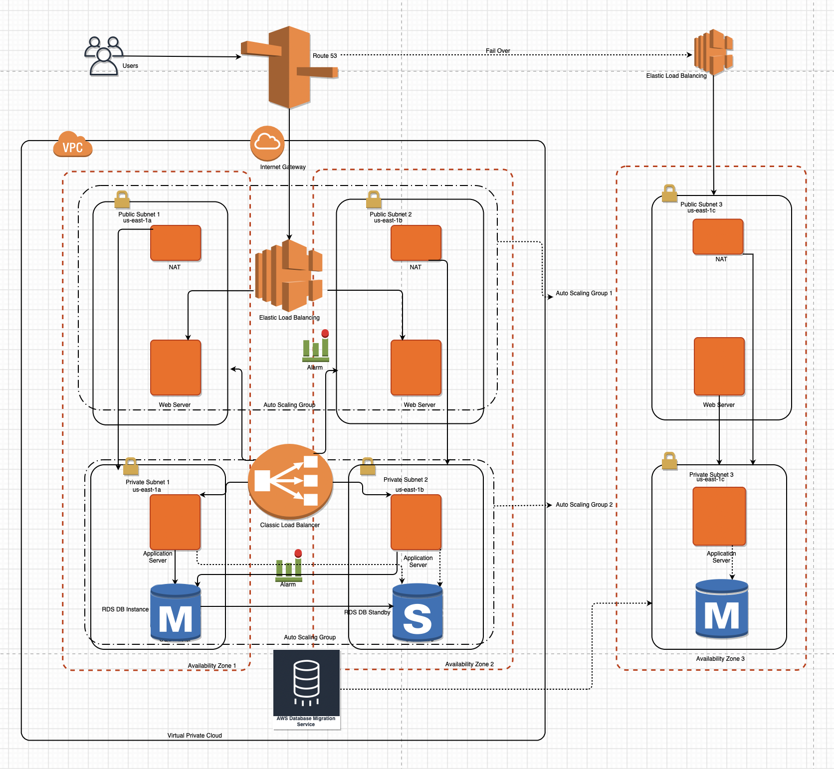
Project 1 – Designing a Cloud Solution
A Medical Company Startup

Slide 22
Thank You!
© 2018 Amazon Web Services, Inc. or its affiliates. All rights reserved. This work may not be reproduced or redistributed, in whole or in part, without prior written permission from Amazon Web Services, Inc. Commercial copying, lending, or selling is prohibited. Corrections or feedback on the course, please email us at: aws-course-feedback@amazon.com. For all other questions, contact us at: https://aws.amazon.com/contact-us/aws-training/. All trademarks are the property of their owners.
Notes:
Thanks for participating!

